Slide 1
GREEN MINE – SIH-1644
AI-powered Carbon Emission Tracking & Neutralization System for the Coal Mining Industry
Team no-11
Pooja Kodgirwar-1602-22-737-157
Ridhi Varshini.S-1602-22-737-187
Archana-1602-22-737-135

Slide 2
1. Motivation of the Theme and Title
Mining industry is under pressure to reduce carbon emissions.
Need for sustainable mining aligned with environmental goals.
‘GREEN MINE’ signifies eco-conscious transformation of traditional coal mining operations.
Aims to blend sustainability with profitability.

Slide 3
2. Problem Statement
Mining industry lacks accurate systems to monitor CO₂ emissions.
Existing manual methods are inefficient and error-prone.
No integrated solution to calculate emissions, estimate carbon credits, and recommend strategies.
Urgent need for intelligent, real-time carbon management in coal mining.

Slide 4
3. Abstract
GREEN MINE is a smart system to estimate CO₂ emissions and suggest neutralization measures.
Uses ML/DL to calculate emissions and generate carbon credits.
Recommends offset strategies like afforestation and renewable energy.
Includes visual analytics and carbon sink analysis using satellite imagery.

Slide 5
4. Existing System and Proposed Solution
Existing: Manual estimations, lack of automation, no predictive analytics.
Proposed: AI-based models for emissions, carbon credit estimation, and strategy recommendation.
Integration of CNN for analyzing carbon sinks via satellite images.
Complete pipeline from data ingestion to visual output.

Slide 6
5. System Architecture
Emission Calculator (Random Forest)
Carbon Credit Estimator (XGBoost)
Strategy Recommender (Random Forest Classifier)
Carbon Sink Analyzer (CNN - EfficientNetB0)
Data input/output pipelines, Visualization with React Dashboard

Slide 7
6. Technology Stack & Dataset
Frontend: React.js
Backend: Flask (Python)
Models: Random Forest, XGBoost, EfficientNetB0 (CNN)
Libraries: scikit-learn, TensorFlow, joblib, seaborn
Dataset: Custom mining dataset (CSV) + EuroSAT satellite image dataset

Slide 8

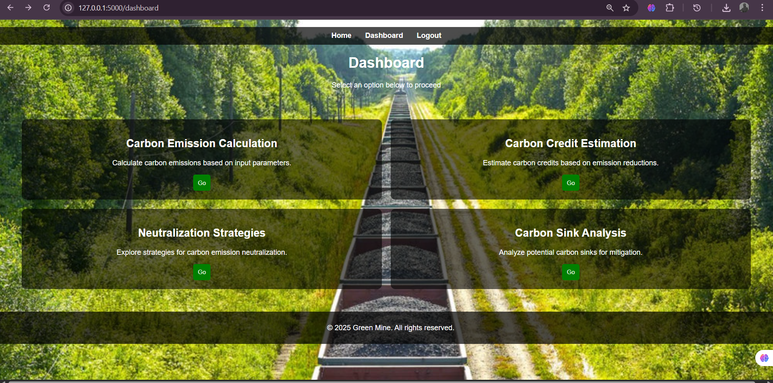
7. Results and Screenshots
CO₂ emission predictions show high accuracy with Random Forest.
Carbon credit estimation using XGBoost has low MAE and RMSE.
Neutralization strategy classification achieved >90% accuracy.
CNN model (EfficientNetB0) achieved high land classification accuracy on EuroSAT.

Slide 9
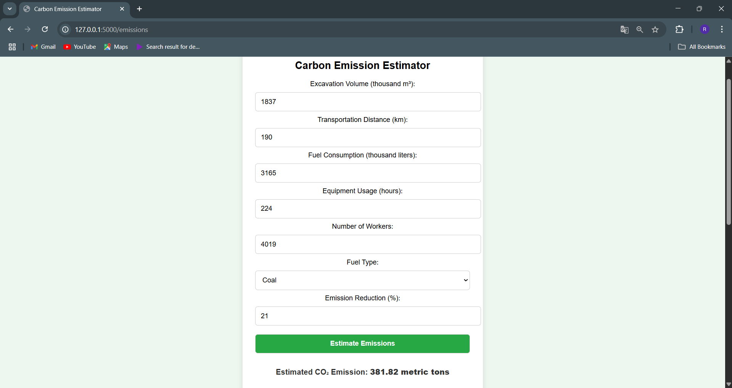
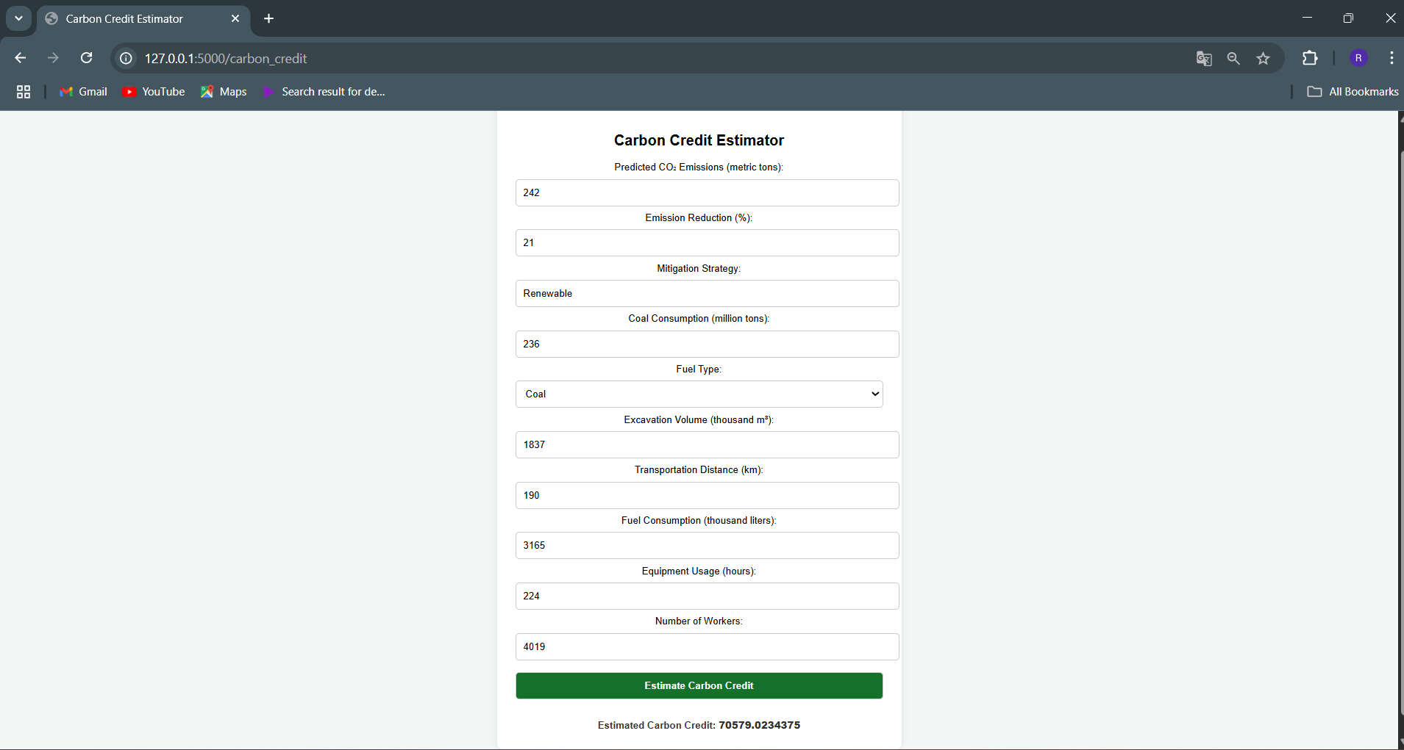
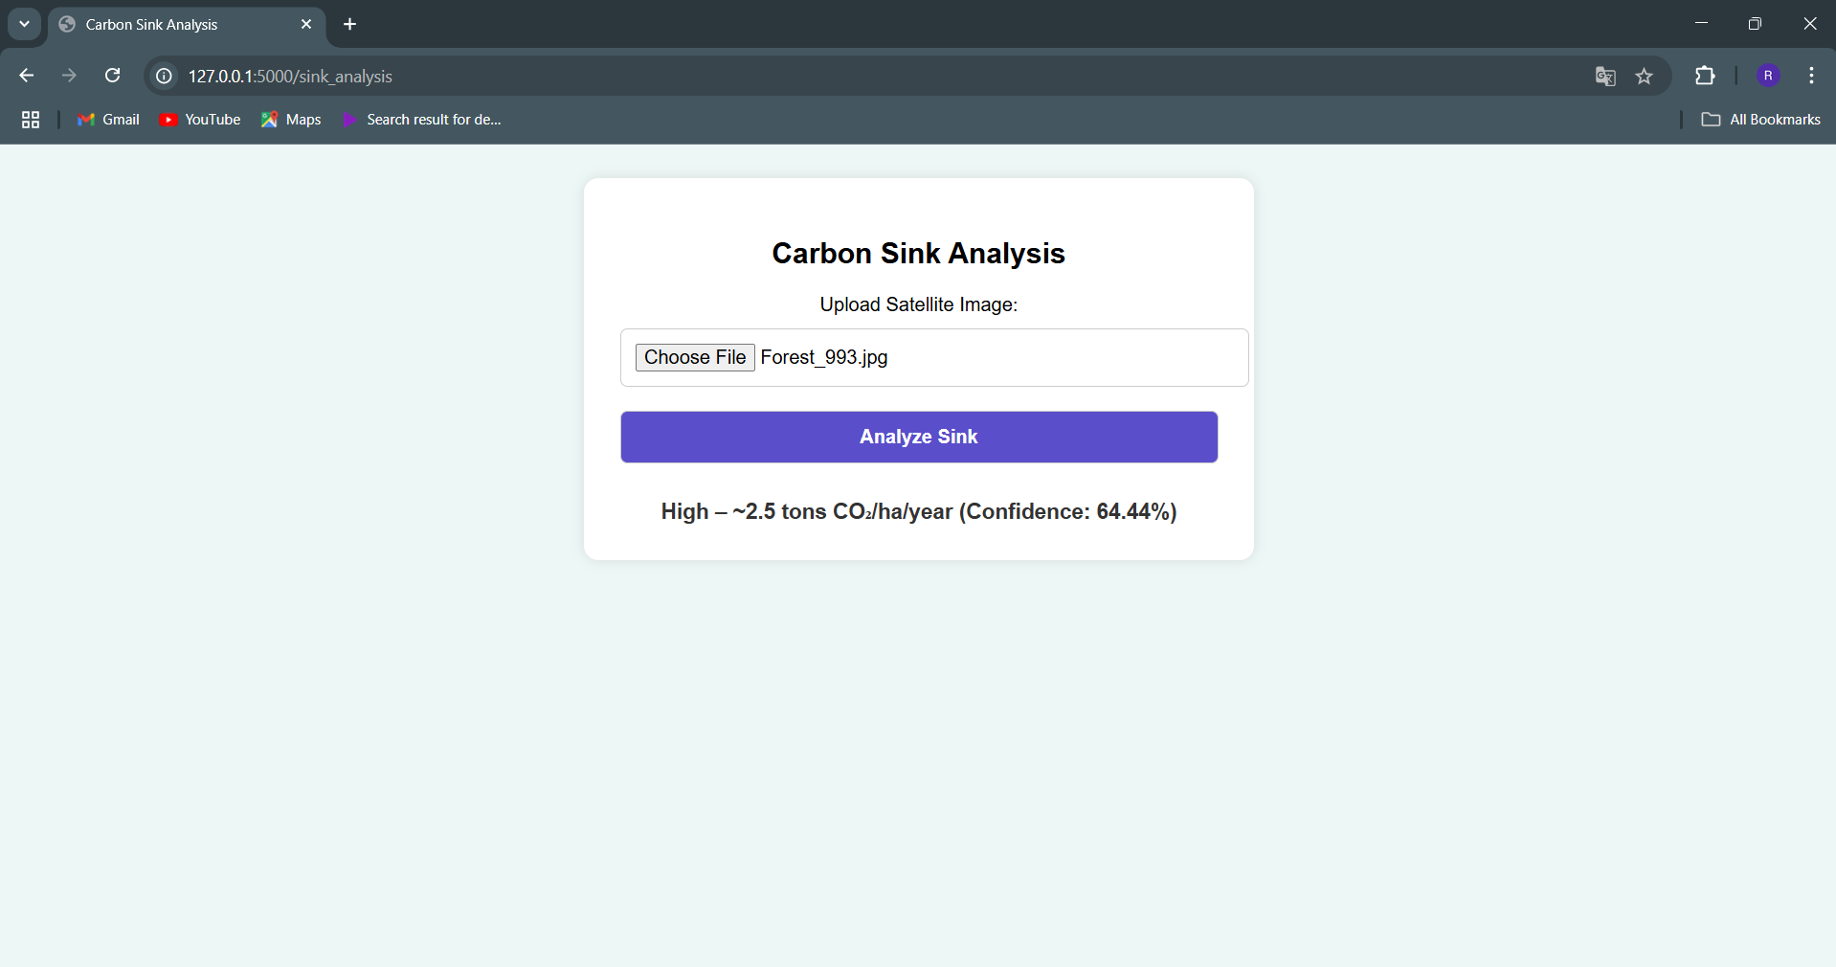
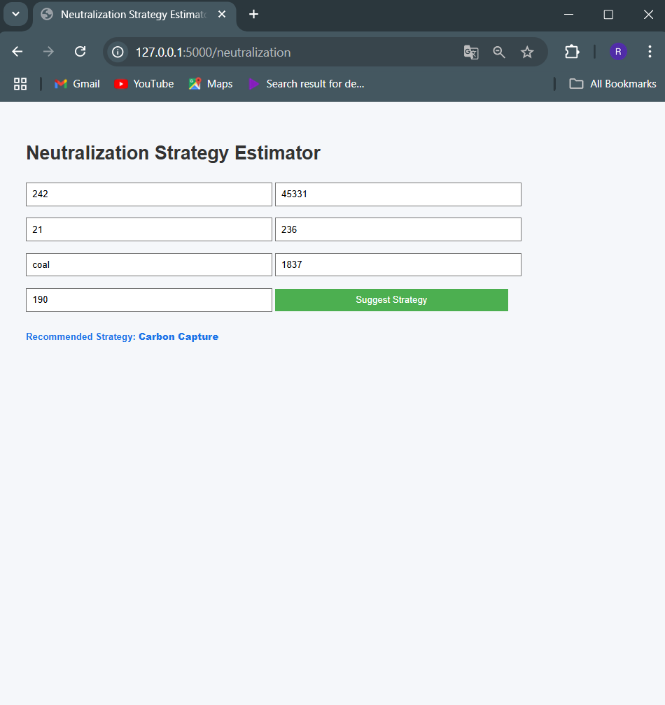

Slide 10
8. Conclusion
GREEN MINE automates emission tracking and neutralization planning.
Enables mining companies to achieve carbon neutrality.
Supports sustainable development while maintaining operational efficiency.
Highly adaptable for other high-emission industries in the future.

Slide 11
9. Future Scope
Integrate real-time data from IoT sensors for live emission monitoring.
Add blockchain-based carbon credit validation.
Scale to other industries: cement, steel, transportation.
Advanced geospatial AI models for deeper carbon sink analysis.

Slide 12
10. References (MLA Format)
“IPCC Guidelines for National Greenhouse Gas Inventories.” IPCC, 2006.
“EuroSAT: Land Use and Land Cover Classification with Sentinel-2.” Helber, Patrick et al., 2019.
Chen, Tianqi, and Carlos Guestrin. “XGBoost: A Scalable Tree Boosting System.” KDD, 2016.
Tan, Mingxing, and Quoc V. Le. “EfficientNet: Rethinking Model Scaling for Convolutional Neural Networks.” ICML, 2019.
Scikit-learn and TensorFlow Official Documentation.

